Slide 1
Bluemix Open Toolchain labs
Jim Palistrant
John Liu
Shumel Bashan

Slide 2
Introduction
A toolchain is a set of tool integrations that support development, deployment, and operations tasks.
The collective power of a toolchain is greater than the sum of its individual tool integrations.
You can assemble all of the services that your Bluemix project needs to succeed, such as issue tracking, source control, testing, monitoring, and notifications, and have them working together in minutes.

Slide 3
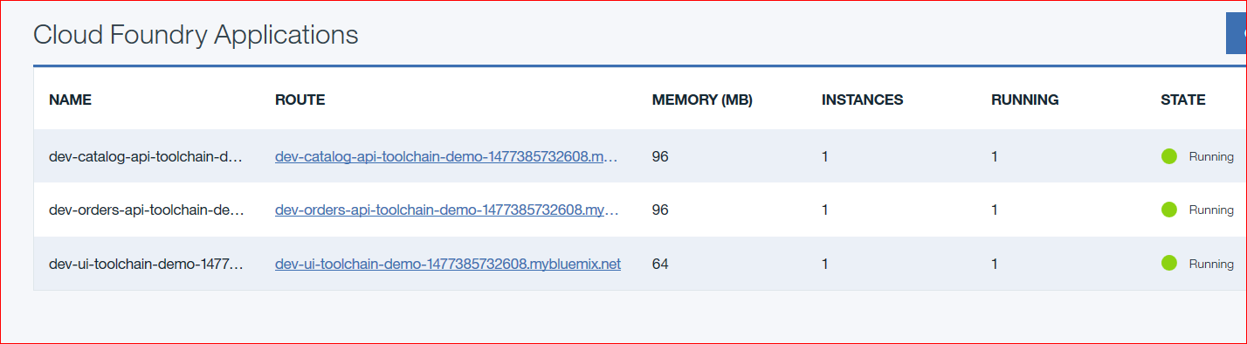
Introduction to Sample Application

Slide 4
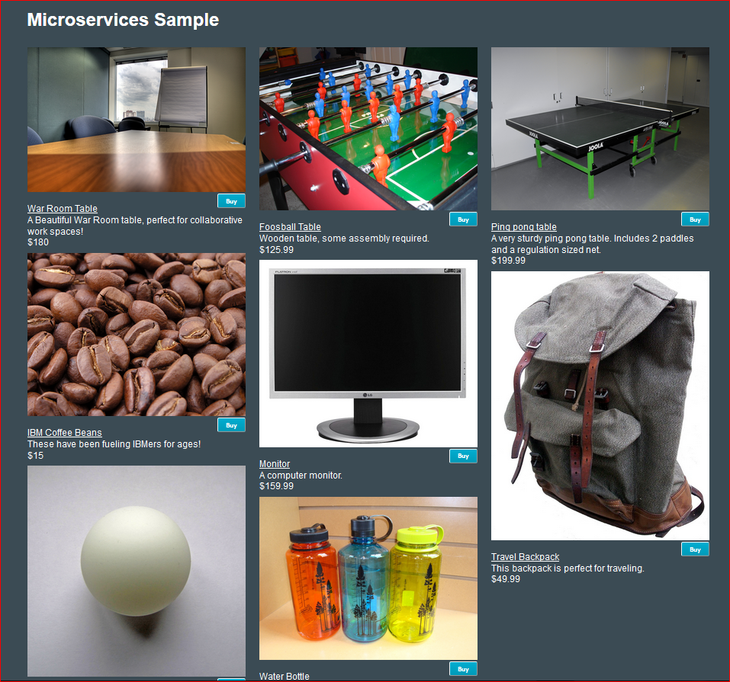
Sample Application - UI

Slide 5
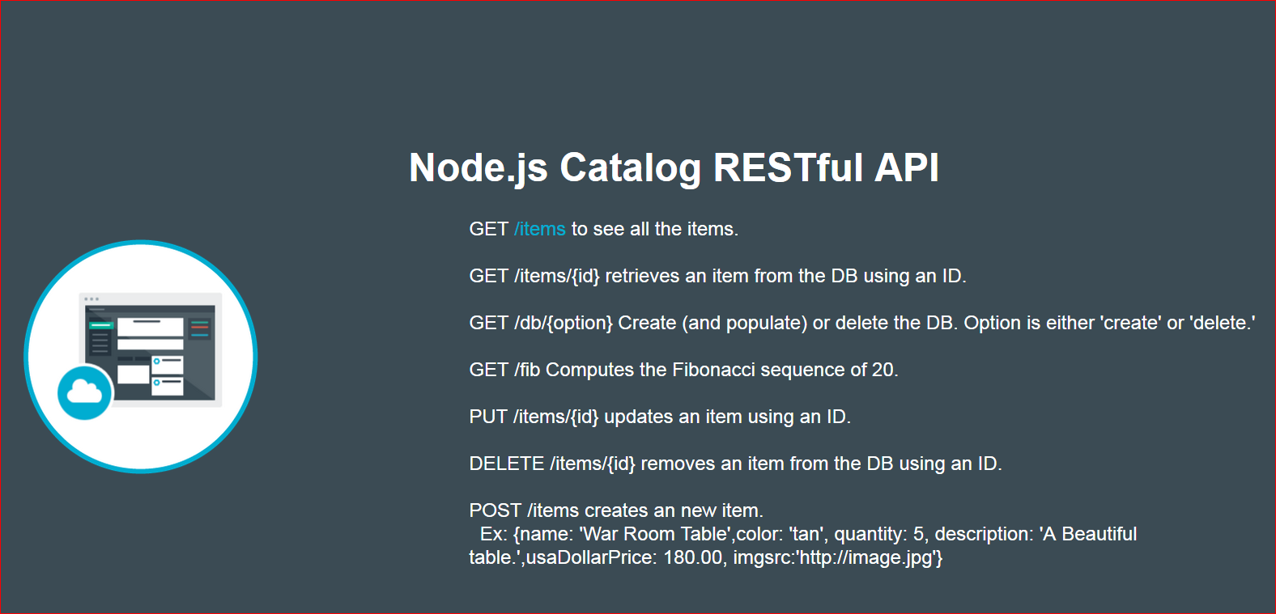
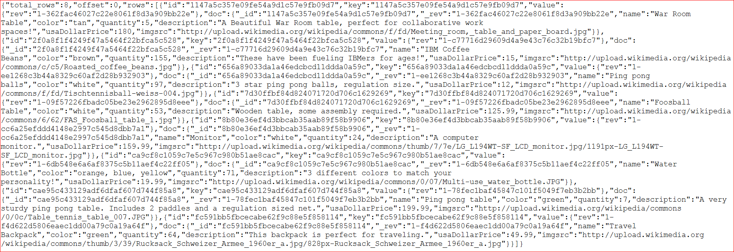
Catalog Microservices

Slide 6
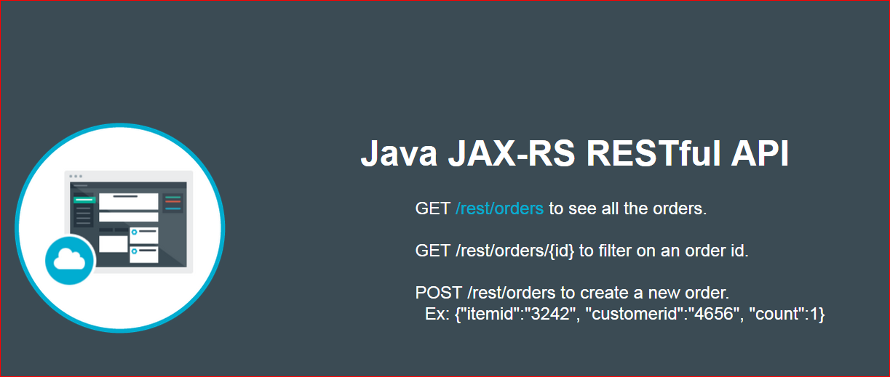
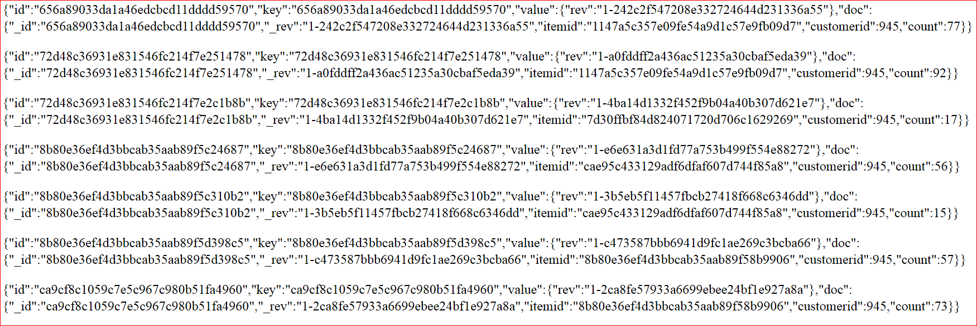
Order Microservices

Slide 7
Sample Application
Order(ms)
UI
Cloudant DB
Catalog(ms)

Slide 8
Pipelines and stages
Space: dev
Space: qa
Space: prod
Order
Order
Order
Order
SCM
Build
Deploy
Deploy
Deploy
Simple Test
UI
UI
UI
UI
SCM
Build
Deploy
Deploy
Deploy
Simple Test
Catalog
Catalog
Catalog
Catalog
SCM
Build
Deploy
Deploy
Deploy
Unit Test
Functional Test
Simple Test

Slide 9


Pipelines and stages
Stage
Space: dev
Space: qa
Space: prod
Delivery Pipeline
Order
Order
Order
Order
Github
Build
Deploy
Deploy
Deploy
Simple Test
UI
UI
UI
UI
Github
Build
Deploy
Deploy
Deploy
Simple Test
Catalog
Catalog
Catalog
Catalog
Github
Build
Deploy
Deploy
Deploy
Unit Test
Functional Test
Simple Test
Job

Slide 10
Lab Objectives
Learn how to set up DevOps pipeline to support application development/deployment using Bluemix Open Toolchain

Slide 11
Agenda
Lab0 (10 mins)
  Set up pre-requisites
Lab1 (20 mins)
  Set up pipeline for Order Microservices
Lab2 (15 mins)
  Set up pipeline for Catalog Microservices
Lab3 (15 mins)
  Set up pipeline for UI
Lab4 (15 mins)
  Add PagerDuty
Lab5 (15 mins)
  Add Slack Integration
Q&A

Slide 12
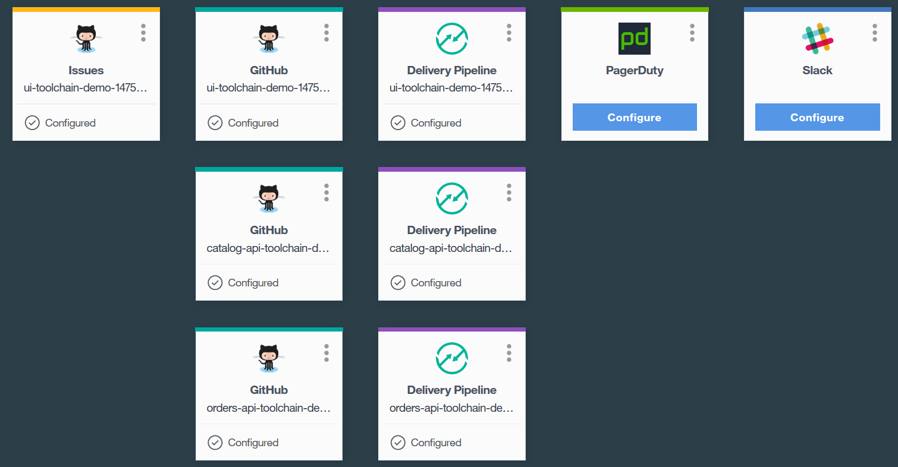
Toolchain Lab End Picture

Slide 13
Lab instructions are in GitHub
https://github.com/palistra/devops-demolabs
Or
Go to https://github.com
Search for “devops-demolabs”

Slide 14
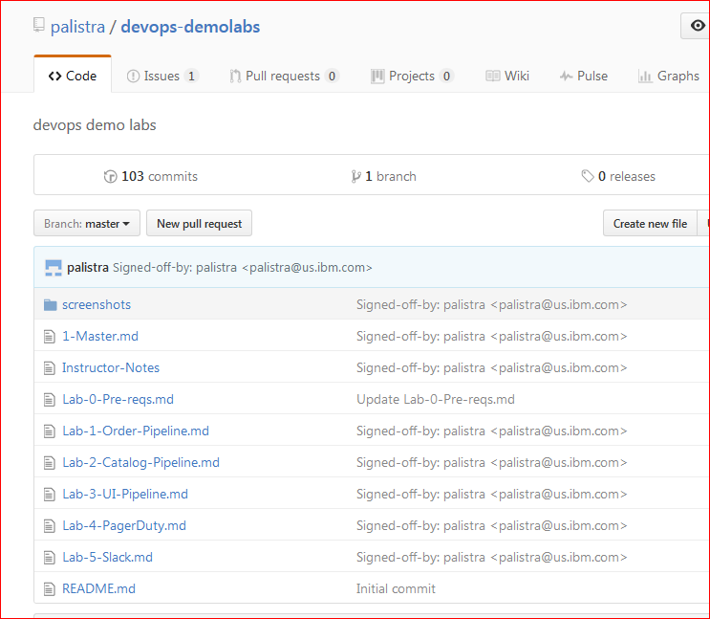
Labs

Slide 15
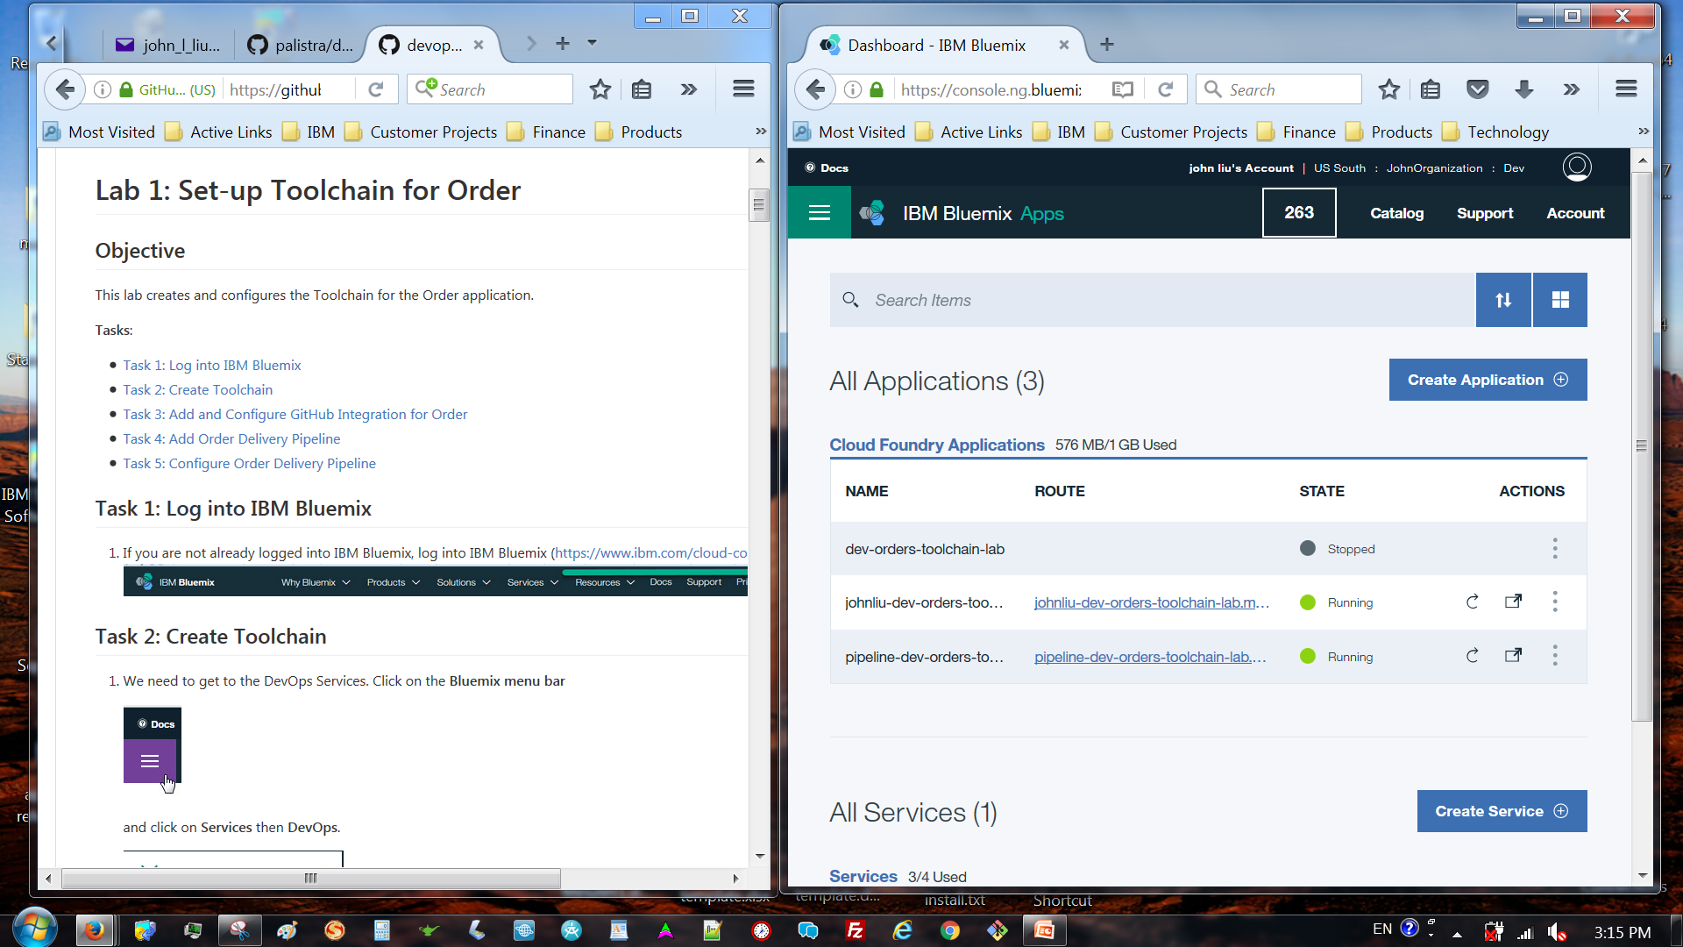
Recommended Approach
Open lab instructions window and bluemix window side by side

Slide 16
Q&A

Slide 17
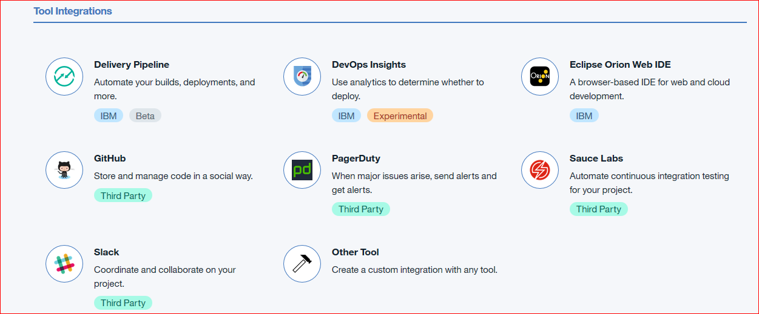
Other Integrations

Slide 18
Thanks!

